Slide 1


Project Foodie.com
Presented By: Harika, Aman & Aswin

Slide 2
Team
Aswin
Harika
Aman

Slide 3
Need of the project…
Problem : As we move on with the “New Normal” because of the Covid-19 situation. It has forced us to change some of our common behaviours. Enjoying our favourite food at our favourite restaurant is one of them…
At that time the COVID-19 pandemic has highlighted the importance of food delivery platforms in ensuring safety and minimizing contact. These platforms have played a crucial role in supporting social distancing measures by providing contactless delivery options.
Not Only this these platforms also supports small and local restaurant to reach a wider customer base. By ordering through these platforms you are also providing a direct support to these restaurants.

Slide 4








CONTENT
1. Introduction
4. UI Tour
7. Team
2. Features
5. Process Flow
8. Q&A
3. Technology
6. Future Scope

Slide 5
Introduction
Our project is a Food Application “Foodie” a dynamic website inspired by Zomato & Swiggy, The popular food discovery and delivery platform. Our website focuses on revolutionizing the way users explore and order food online. With an extensive restaurant database, detailed menus.
Our main focus is to provide our customer with healthy, hygienic and tasty food. Even our moto is “Your tasty, hot, and hygienic food is just one click away.”
Our Platform facilitates two types of User i.e. Administrator and Customer.

Slide 6
Features
We have tried to provide most of the essential functionalities to our customers and administration.
For Login customer and admin need to go through authentication and validation process
Customer-:
Customer can add items to his favourite section. And from favourites he can Order or can delete that item.
Customer can Order multiple Food items from multiple restaurants.
Customer can also cancel that order.
Customer can View/Update his profile.
For Payment we have provided RazorPay API
Customer can search the item and restaurants
Administration-:
Admin can Add/Delete/Update Restaurants in database.
Admin can Add/Update Item for a Particular Restaurant.

Slide 7






Technology Used In The Project
Technology / domain: Java
Middleware : Spring boot and Spring cloud
Front-End : HTML 5, CSS 3, TS, Bootstrap, Angular
Server : Tomcat 8.5
Database: MYSQL , MongoDB
Frameworks : Hibernate, Angular
Testing : Junit , Mockito
Containerization : Docker Desktop
API : RazorPay, Twilio(Message)

Slide 8
Architectural Design
Eureka Server
API
G
A
T
E
W
A
Y
Auth Service
Login
Feign Client
Add/Update User
MySql DB
Angular
User Service
Add User
Client
Search/add
Restaurant Service
Mongo DB
Order
Order Service
Notification Service
Payment Service
Payment Info( RazorPay API)
On Success

Slide 9
Admin Flow Process
Add / Update Restaurants
Admin
Remove Restaurant
Add Item/Menu To Particular Restaurant
Login Page
Admin Module
Update Item
On Success
Check Profile
Check Role
If Role == adminRole
Update Profile

Slide 10
User Flow Process
View Items/Restaurants
User
Add Items to Favourites /Remove/
View Favourites
If already Exist / registered
Login Page
Add Items to Cart / Remove
User Module
Payment
Else Move to registration
On Successful Registration
orders
Registration Page
Check Profile
Update Profile

Slide 11
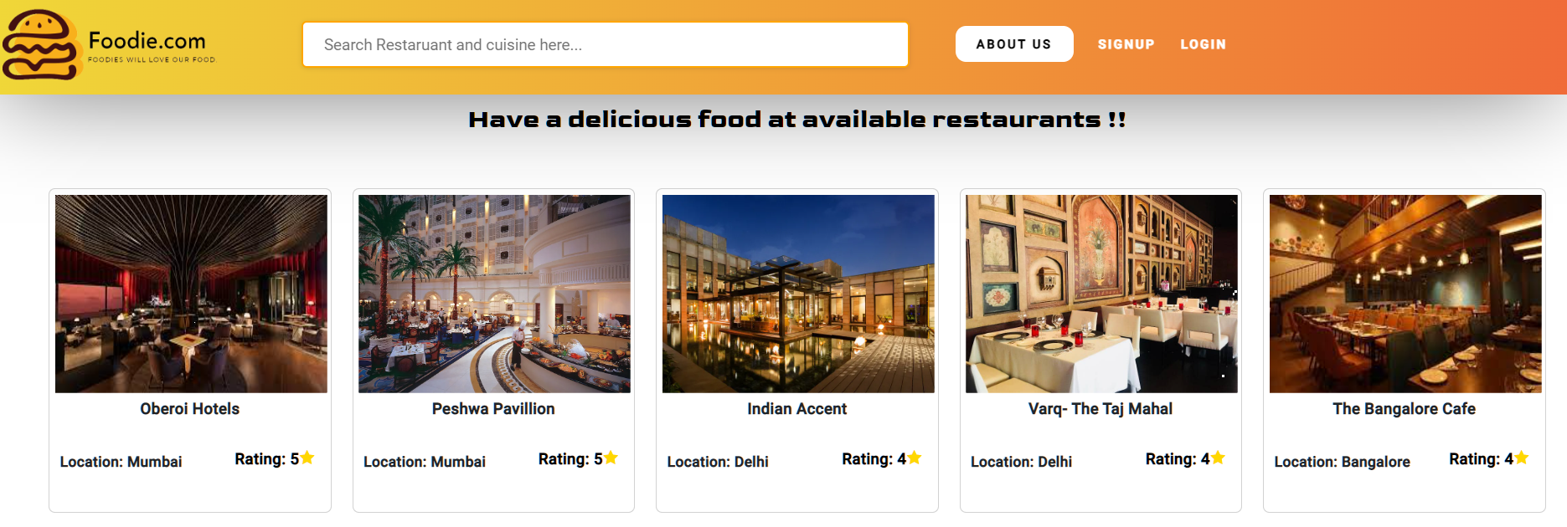
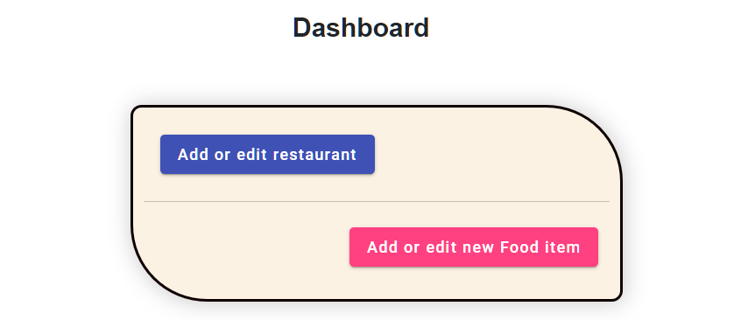
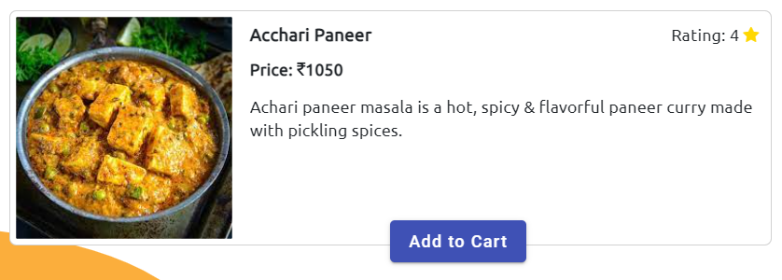
User Experience
The Foodie.com app is designed to provide you with a seamless and user-friendly experience. Easily navigate through the app to explore various restaurants, browse menus, and place orders with just a few taps. You can personalize your preferences, save your favorite orders, add them into cart. Foodie.com also offers secure payment options, making your ordering process hassle-free.

Slide 12

Future Scope
In coming time we are Planning to Provide Restaurant location, Using google maps Api and we’ll also try to provide new user a discount on his first order
We’ll also try to implement loyalty program – to encourage customer retention, where user will receive rewards on the basis of orders.
and also social media Integration as well, so if user wants to share something about the items/restaurants, they can share that on social media.

Slide 13

Any Query

Slide 14
Thank you

